Slide 1
Chapter 4
Continuous Random Variables and Probability Distributions

Slide 2
Introduction
We discuss the basic properties of continuous random variables and focus in detail on the normal random variable.

Slide 3
Continuous Random Variables
Recall that a continuous random variable has values lying on a continuum.
The mathematical model for a continuous rv X is a probability density function (pdf) whose graph is a probability density curve.

Slide 4
Continuous Random Variables
Continuous rv’s are used to measure physical characteristics such as height, weight, time, volume, position, etc...
Examples
1. Let Y be the height of a person (a real
number).
2. Let X be the volume of juice in a can.
3. Let Y be the waiting time until the next
car goes through an intersection.

Slide 5
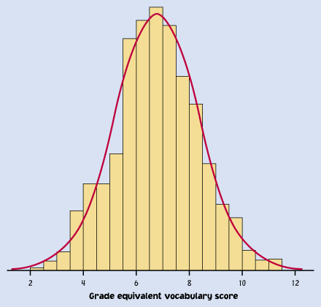
A probability density curve is the curve that smooths out or fits a histogram.

Slide 6
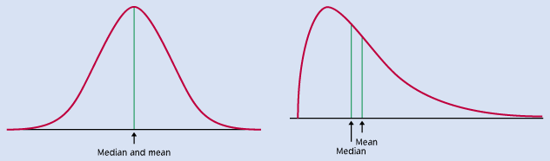
Some Probability Density Curves

Slide 7
Properties of pdf’s
Let f(x) denote the pdf of a continuous rv X.
NOTE: (1) f(x) ≥ 0
(2) ∫ f(x) dx = 1 _{b}
(3) P(a < X < b) = ∫_{a} f(x) dx
(4) P(X = a) = 0
(5) P(a ≤ X < b) = P(a ≤ X ≤ b)
= P(a < X ≤ b) = P(a < X < b)

Slide 8
Uniform Distribution
EXA Let X be a continuous rv with pdf
f(x) = 1/4, 2 < x < 6. Find P(X > 3).
Defn X is a Uniform(a,b) rv iff
f(x) = 1/(b - a), a < x < b.
Notes:
f(x)
|
1/4 | -----------------------
|_______________________ x
0 1 2 3 4 5 6
P(X > 3) = 3/4.
This can be seen graphically, A = length times width.
6 6
Or compute the integral: ∫₃ 1/4 dx = x/4 |₃ = 6/4 - 3/4 = 3/4.

Slide 9

CDF
The cdf of X is F(x) = P(X ≤ x). In the continuous case, this is computed by
Here the cdf is a continuous function.
Notes:
.

Slide 10
CDF
EXA Let X be a continuous rv with pdf
f(x) = 1/4, 2 < x < 6. Find F(x) and
graph it.
Notes:
For x between 2 and 6,
F(x) = =x/4 -1/2
So F(x) = 0, x < 2
x/4 – ½, 2 ≤ x ≤ 6
1, x > 6
Make graph.

Slide 11
CDF
We can find cdf of X from pdf of X from definition.
Can we find pdf of X from cdf of X? YES
f(x) = F’(x)
EXA Find f(x) for X with cdf F(x) = 0, x ≤ 0
1 – e^{-x} , x > 0.
Notes:
F(x) = 1 - e^{-x} , x > 0
f(x) = - e^{-x} (-1) = e^{-x} , x > 0
This is an Exponential (1) distribution.

Slide 12
Continuous rv’s
EXA Let Y denote total waiting time to be served in minutes.
f(y) = y/25, 0 < y < 5
2/5 - y/25, 5 < y < 10
a. Sketch density curve.
b. Verify that f is a pdf.
c. Find P(Y ≤ 3).
d. Find P(Y ≤ 8).
Notes:
a. density curve is a triangle.
5 10 5 10
b. ∫₀ y/25 dy + ∫₅ (2/5 - y/25) dy = y² / 50 |₀ + 2y/5 - y² / 50 |₅
= (25/50 - 0) + (20/5 - 100/50) - (10/5 - 25/50)
= .5 + 4 -2 -2 + .5 = 1.0
3 3
c. P(Y ≤ 3) = ∫₀ y/25 dy = y² / 50 |₀ = 9/50 = .18
10 10
d. P(Y ≤ 8) = 1 - P(Y > 8) = 1 - ∫₈ (2/5 - y/25) dy = 1 - (2y/5 - y² / 50) |₈
= 1 - [(20/5 - 100/50) - (16/5 - 64/50)]
= 1 - [4 - 2 - 96/50] = 1 - .08 = .92

Slide 13
Continuous rv’s
EXA Let X denote error in a measurement in mm.
f(x) = .09375(4 - x²) , -2 < x < 2
b. Find P(X > 0).
c. Find P(-1 < X < 1).
d. Find P(X < -.5 or X > .5).
Notes:
2 2
b. P(X > 0) = ∫₀ .09375 (4 - x² ) dx = .09375(4x - x³ /3)|₀
= .09375(8 - 8/3) = .5
1 1
c. P(-1 < X < 1) = ∫₋₁ .09375 (4 - x² ) dx = .09375(4x - x³ /3)|₋₁
= .09375 [(4 - 1/3) - (-4 + 1/3)]
= .09375 (8 - 2/3)
= .6875
d. P(X < -.5 or X > .5) = 1 - P(-.5 < X < .5)
.5 .5
= 1 - ∫_{-.5} .09375 (4 - x² ) dx = 1 - .09375(4x - x³ /3)|_{-.5}
= 1 - .09375 [(2 - 1/24) - (-2 + 1/24)]
= 1 - .09375 (3.91666667) = 1 - .3672 = .6328

Slide 14
Percentiles, Mean, and Variance
Defn Let p be in (0,1). The 100pth percentile of the distribution of a continuous rv X, denoted by η(p), is defined as the value such that _{η(p)}
∫_{-∞} f(x) dx = p.
EXA Find η(p) where X has pdf f(x)=4e^{-4x}, x>0.
(This is an Exponential(4) distribution)
Notes:
η(p) η(p)
∫₀ 4e^{-4x} dx = p ⇒ -e^{-4x} |₀ = 1 - e^{-4η(p)} = p
⇒ 1 - p = e^{-4η(p)}
⇒ ln(1 - p) = -4η(p)
⇒ η(p) = -ln(1 - p) / 4 //

Slide 15
Percentiles, Mean, and Variance
Defn The median (m) of a continuous distribution is the 50th percentile.
EXA In the previous example,
m = η(.5) = -ln(.5)/4 = .1733

Slide 16
Percentiles, Mean, and Variance
Defn The expected value or mean of a continuous rv X is given by
∞
μ = E(X) = ∫_{-∞} x f(x) dx.
EXA Find μ where X has pdf f(x)=4e^{-4x}, x>0.
∞
Defn E(h(X)) = ∫_{-∞} h(x) f(x) dx.
EXA Find E(X²) in previous example.
Notes:
∞ ∞ ∞ ∞
μ = ∫₀ x4e^{-4x}dx = -xe^{-4x} |₀ - ∫₀ -e^{-4x}dx = 0 + [ -(1/4)e^{-4x} ]|₀ = 0 + 1/4 = 1/4
↑
u=x dv= 4e^{-4x}dx parts
du=dx v= -e^{-4x}
⁻⁻⁻⁻⁻⁻⁻⁻⁻⁻⁻⁻⁻⁻⁻
∞ ∞ ∞ ∞
E(X²) = ∫₀ x² 4e^{-4x}dx = -x² e^{-4x} |₀ - ∫₀ -2xe^{-4x}dx = 0 + ∫₀ 2x e^{-4x} dx
↑
u=x² dv= 4e^{-4x}dx parts
du=2xdx v= -e^{-4x}
∞
= 2/4 ∫₀ 4x e^{-4x} dx = (1/2)(1/4) = 1/8
↑ ↑
integral is mean of X E(X) found above

Slide 17
Percentiles, Mean, and Variance
Defn Let X be a continuous rv. The variance of X is given by
∞
V(X) = σ² = σ²_{X} = E[(X-μ)²] = ∫_{-∞} (x-μ)² f(x)dx.
The standard deviation of X is given by σ_{X}, which is the square root of σ²_{X}.

Slide 18
Percentiles, Mean, and Variance
Recall that
V(X) = E(X²) - (E(X))²
as in the discrete case.
EXA Find the variance and standard deviation of X in previous example.
Notes:
V(X) = 1/8 - (1/4)² = 2/16 - 1/16 = 1/16

Slide 19
Uniform Distributon
Defn X is a Uniform(a,b) rv iff
f(x) = 1/(b - a), a < x < b.
For the Uniform(a,b), E(X) = (a + b)/2 and V(X) = (b – a)²/12.

Slide 20
Normal Distribution
An important class of density curves is the NORMAL density curve, a bell-shaped curve centered at its mean μ. A normal distribution is completely defined by its mean μ and its standard deviation σ.

Slide 21
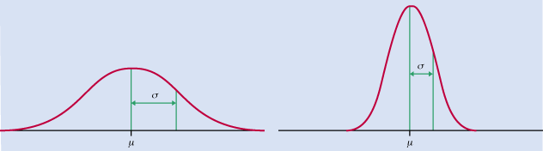
Normal Density Curve

Slide 22
Normal Distribution
Normal models are good for many types of data like test scores, repeated measurements on the same quantity, characteristics of biological populations (Heights, Weights, Yields).

Slide 23
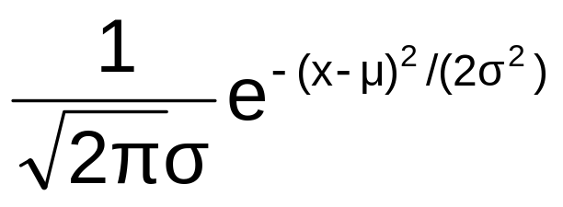
Normal pdf
X has a N(μ, σ²) distribution when the pdf of X is the following:
f(x) = , -∞ < x < ∞
(-∞ < μ < ∞ , σ² > 0)

Slide 24
Normal Distribution
Fact: E(X) = μ and V(X) = σ² .
μ is where the density is centered about and σ (or σ²) indicates how spread out the curve is.
The larger the σ (or σ²), the more spread out the curve is.
See previous figure.

Slide 25
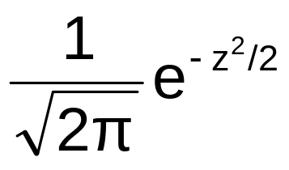
Standard Normal rv (N(0,1))
Z has a N(0, 1) (or standard normal) distribution when the pdf of Z is the following:
f(z) = , -∞ < z < ∞
Notation: Let Φ(z) = P(Z ≤ z), the cdf of Z.
Values are found in Appendix Table III.

Slide 26
N(0,1) Table
Use Moore’s Table.
EXA Find the following probabilities:
a. P(Z ≤ 2.21)
b. P(Z ≤ -1.32)
c. P(Z > 1.64)
d. P(-.09 < Z < .68)
Notes:
a. P(Z ≤ 2.21) = Φ(2.21) = .9864
b. P(Z ≤ -1.32) = Φ(-1.32) = .0934
c. P(Z > 1.64) = 1 - Φ(1.64) = 1 - .9495 = .0505
or
P(Z > 1.64) = Φ(-1.64) = .0505
d. P(-.09 < Z < .68) = Φ(.68)- Φ(-.09) = .7517 - .4641 = .2876

Slide 27
Percentiles of N(0,1)
Note: The 100pth percentile is the number
z such that P(Z ≤ z) = p.
EXA Find the 70th percentile of N(0,1).
Notes:
Make picture.
70th percentile = .52

Slide 28
Nonstandard Normal
Prop. X is N(μ, σ² ) iff Z = (X - μ)/σ is N(0,1).
We can use this when computing probabilities concerning X.
For example, P(X < a) = P[(X - μ)/σ < (a - μ)/σ]
= P(Z < (a - μ)/σ)
= Φ((a - μ)/σ).
Then go to table and look up (a - μ)/σ and Voila!
Notes:
Make picture of P(X < a) and Φ((a - μ)/σ).

Slide 29
Nonstandard Normal
EXA Let X denote the Rockwell hardness of a particular alloy (in kgf (kilogram-force)). Assume X is N(70,9).
a. Find P(67 < X < 75).
b. Find c such that P(70 - c < X < 70 + c) = .95.
Notes:
a. P(67 < X < 75) = P[(67 - 70)/3 < Z < (75 - 70)/3] = P(-1 < Z < 1.67)
= Φ(1.67) - Φ(-1) = .9525 - .1587 = .7938
b. P(70 - c < X < 70 + c) = .95
iff P[((70-c)-70)/3 < Z < ((70+c)-70)/3) = .95
iff P(-c/3 < Z < c/3) = .95
iff P(Z < c/3) = .975 (make picture)
iff c/3 = 1.96
iff c = 5.88

Slide 30
Empirical Rule
For a normal distribution:
1. Roughly 68% of the values are within one standard deviation of the mean.
2. Roughly 95% of the values are within two standard deviations of the mean.
3. Roughly 99.7% of the values are within three standard deviations of the mean.
Notes:
Check #1:
Let X have a N(μ,σ²).
P(μ - σ < X < μ + σ) = P[ ((μ - σ) - μ)/σ < (X - μ)/σ < ((μ + σ) - μ)/σ]
= P(-1 < Z < 1) = Φ(1) - Φ(-1) = .8413 - .1587
= .6826 ≈ .68

Slide 31
Empirical Rule
For a normal distribution:
P(μ – σ < X < μ + σ) = 0.6826
P(μ – 2σ < X < μ + 2σ) = 0.9544
P(μ – 3σ < X < μ + 3σ) = 0.9974

Slide 32
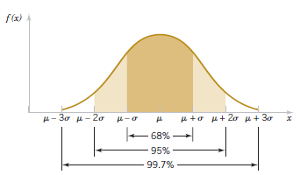
Empirical Rule

Slide 33
Empirical Rule
Illustration: Say HEIGHT has a N(67,9)
distribution.
It would be unusual to observe a height outside
(67 - 6, 67 + 6) = (61, 73).
It would be extremely unusual to observe a
height outside (67 - 9, 67 + 9) = (58, 76).

Slide 34
Percentiles of a Normal
Prop. The 100pth percentile of a N(μ, σ²) equals
μ + (100pth percentile of N(0,1)) × σ.
EXA Back to Rockwell hardness example, where X is N(70, 9).
Find the 70th percentile of this distribution.
Notes:
Proof of Prop.
P(X < x) = p iff P(Z < (x - μ)/σ) = p
iff (x - μ)/σ = 100pth percentile of N(0,1)
iff x = μ + (100pth percentile of N(0,1)) × σ //
EXA 70th percentile of N(70, 9) is
70 + (70th percentile of N(0,1) × 3
= 70 + (.52)(3) = 70 + 1.56
= 71.56

Slide 35
Using R
To find P(Z ≤ 2):
> pnorm(2)
[1] 0.9772499
To find P(X < 75) for a N(70,9):
> pnorm(75,70,3)
[1] 0.9522096

Slide 36
Using R
To find 70th percentile of N(0,1) :
> qnorm(.7)
[1] 0.5244005
To find the 70th percentile of a N(70,9):
> qnorm(.7,70,3)
[1] 71.5732

Slide 37
Normal Approx. to Binomial
Assume that X is a Binomial(n,p) rv.
If np and n(1 - p) are both at least 10, then X is approximately N(np, np(1 - p)).
Using this and the continuity correction, you can get a pretty good approximation plus saving you loads of time.
Notes:
Illustration; Find P(X > 140) for a Binomial(200,.65) using the binomial probability formula. This would be a big pain without R, etc.

Slide 38
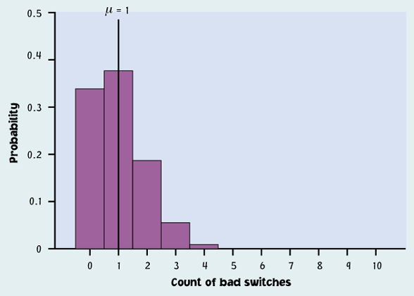
EXA Let X be a Binomial (10, .1) rv.
Notes:
Explain continuity correction using the picture above, say for P(X > 1).
Of course, the normal approximation would not be appropriate here.

Slide 39
Normal Approx. to Binomial
EXA Roll a fair die 200 times. Find the
probability of rolling at least 30 6’s.
S = roll a 6
p = 1/6
n = 200
X = # of 6’s (out of 200)
Find P(X ≥ 30).
Notes:
np = 33.33 and n(1-p) = 166.67 are both at least 10
So X is approximately N(33.33, 27.7778)
↑ ↑
(200)(1/6) (200)(1/6)(5/6)
P(X ≥ 30) = P(X > 29.5) ≈ P(Z > (29.5 - 33.33)/5.27046)) = P(Z > -.73)
↑
continuity correction
= Φ(.73) = .7673

Slide 40
Exponential Distribution
An Exponential(λ) rv X has pdf
f(x) = λe^{-λx} , x > 0 (λ > 0).
E(X) = 1/λ and V(X) = 1/λ².
We have previously looked at an Exponential(1) and an Exponential(4).

Slide 41
Exponential Distribution
EXA Let X denote the time in hours from the start of the interval until the time of the first log-on. Assume X is an Exponential(25) rv. Find the probability that there are no log-ons in the next 6 minutes.
f(x) = 25e^{-25x} , x > 0 (λ > 0).
Notes:
6 minutes = 0.1 hours
P(no log-ons in the next 6 minutes) = P(X > 0.1)
=
= 0 + e^{-2.5}
= 0.0821

